Slide 1
Binary Search Trees
Raesetje Sefala

Slide 2
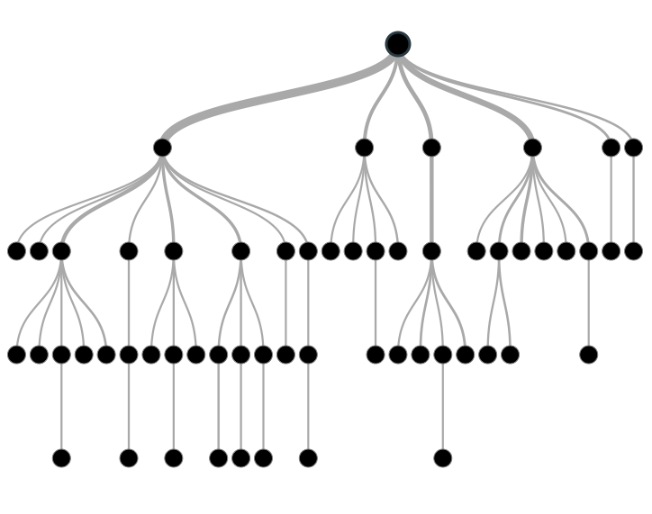
TREES (Graph analogy)
Trees
Roots
Branches
Leaves
Graph
Node
Vertices
Edges

Slide 3
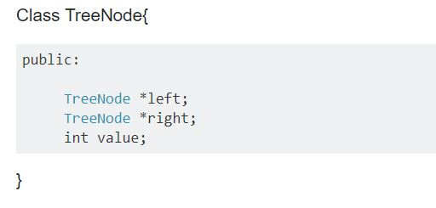
TREES (Graphs)
Parents and children
≤ 2 children → Binary tree
If all nodes have 0 or 1 children → Linked List

Slide 4
BINARY SEARCH TREE
Also called “ordered binary tree”
Type of binary tree where the nodes are arranged in order:
for each node, all elements in its left subtree are less to the node (<),
and all the elements in its right subtree are greater than the node (>)

Slide 5
BINARY SEARCH TREE
Finding Root
Finding minimum value
Finding maximum value

Slide 6
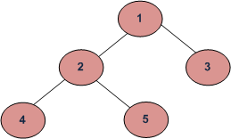
BINARY SEARCH TREE
Lowest Common Ancestor(LCA)
Let T be a rooted tree.
The lowest common ancestor between two nodes n1 and n2:
is the lowest node in T that has both n1 and n2 as descendants (where we allow a node to be a descendant of itself)
LCA of 4 and 5 is:
2
LCA of 2 and 5 is:
2

Slide 7
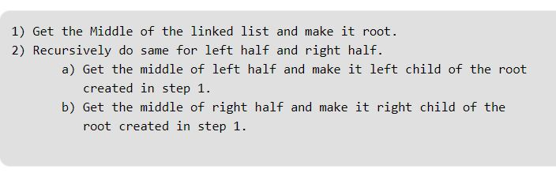
WHAT’S THE LINK?
Sorted Linked List to BST
Input: Linked List 1->2->3
Input: Linked List 1->2->3->4->5->6->7

Slide 8
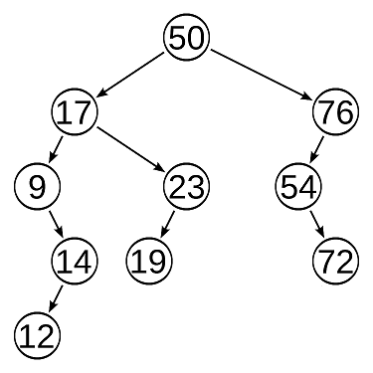
STRUCTURE
Height – the length of the path from the root to the furthest leaf
Height = 4

Slide 9
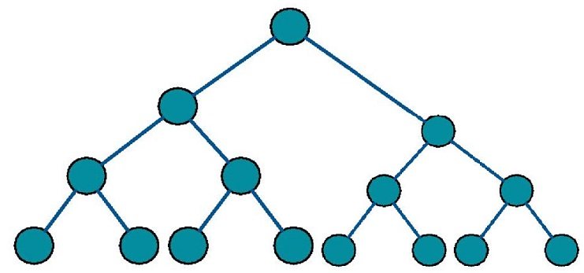
STRUCTURE
Perfect tree
Max number of nodes

Slide 10
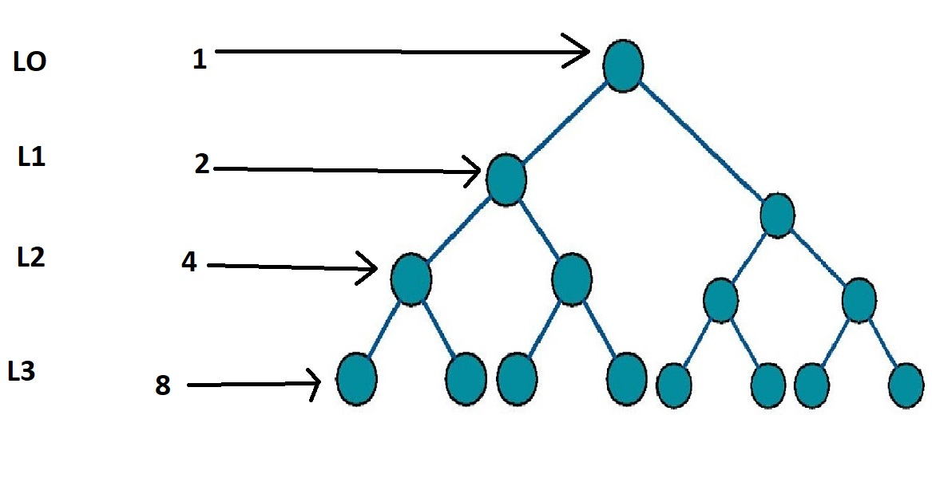

STRUCTURE
Perfect Tree
n $=\sum_{i=0}^{h}{2^{i}=}$ $2^{h+1}−1$
Derive the height?

Slide 11
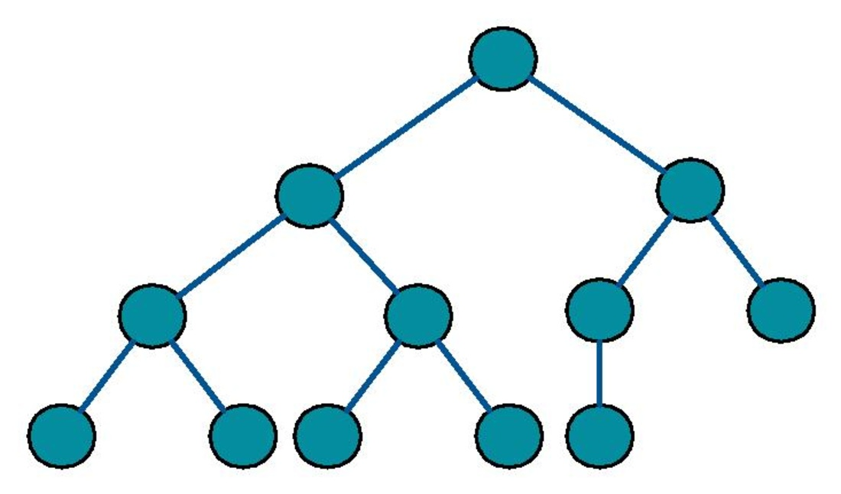
STRUCTURE
Complete tree
Filled from the left
H ϵ O(log n)

Slide 12
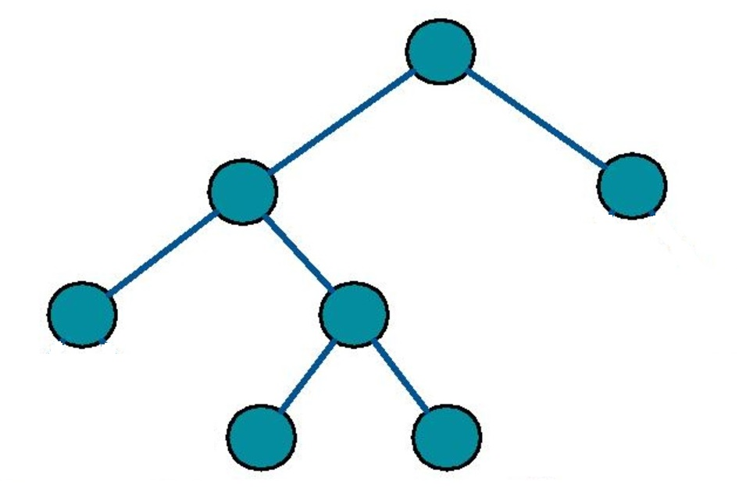
STRUCTURE
Full Tree
0 or 2 children

Slide 13
OPERATIONS
Insertion
Always at the leaf
L< V ≤ R
Searching
Case 1: O(1)
Case 3: O(log n)
Case 2: O(n)

Slide 14
OPERATIONS
Deletion
Case 1: No child- a leaf
Set child of parent to null
Wipe the node from memory

Slide 15
OPERATIONS
Deletion
Case 2: One child
Link grandparent to the child(so you don’t lose the link)
Wipe the node from memory

Slide 16
OPERATIONS
Deletion
Case 3: Two children
Option 1 | Option 2
Find max in the left subtree Copy the value in the target node Delete the duplicate from the subtree using the other cases | Find min in the right subtree Copy the value in the target node Delete the duplicate the subtree using the other cases

Slide 17
TRAVERSALS
Pre order
< root > < left > < right >
In order
< left> < root> < right >
Post order
< left > < right > < root >

Slide 18
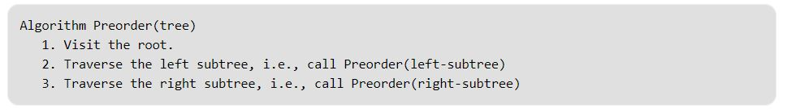
TRAVERSALS
Preorder
< root > < left > < right >
Pseudocode:
Creates a copy of the tree
Gets prefix tree expression: Polish notation
Preorder: 1 2 4 5 3
Ref : http://www.geeksforgeeks.org/tree-traversals-inorder-preorder-and-postorder/

Slide 19
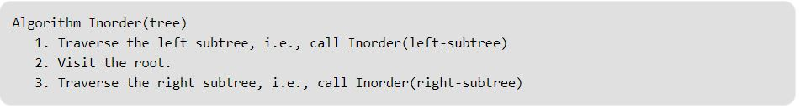
TRAVERSALS
Inorder
< left> < root> < right >
Pseudocode:
Gives nodes in non-decreasing order
Inorder: 4 2 5 1 3
Ref : http://www.geeksforgeeks.org/tree-traversals-inorder-preorder-and-postorder/

Slide 20
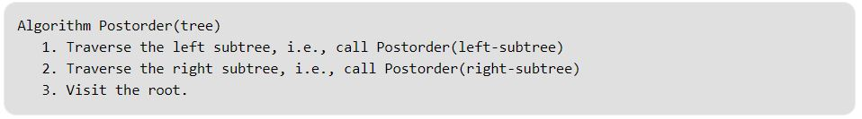
TRAVERSALS
Postorder
< left> < root> < right >
Pseudocode:
Used to delete the tree
Gets postfix expression
Postorder: 4 5 2 3 1
Ref : http://www.geeksforgeeks.org/tree-traversals-inorder-preorder-and-postorder/

Slide 21
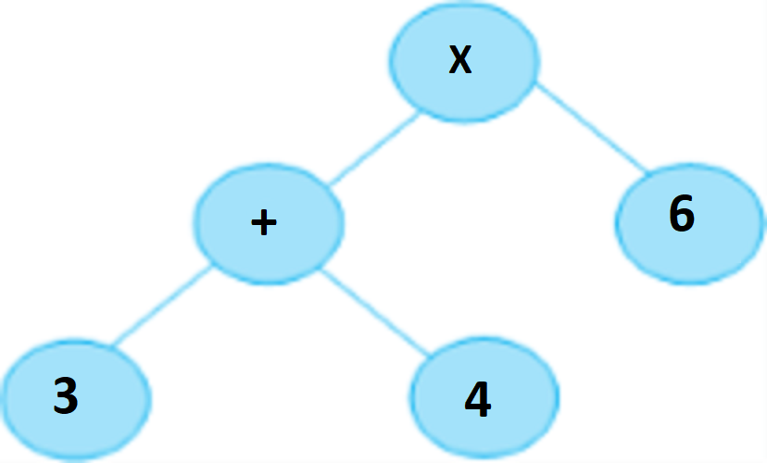
TRAVERSALS
Postfix notation
Operators are written after their operands
3 4 + 6 x
Polish notation
Operators are written before their operands
+ 3 4 x 6

Slide 22
SUMMARY
Trees as graphs
Binary Search Trees
Link to linked lists
BST:
Structure
Operations
Traversals

Slide 23

Hopefully you can say….

Slide 24
RESOURCES
Geeks for geeks- http://www.geeksforgeeks.org/binary-search-tree-data-structure/
Infix, Postfix and Prefix -http://www.cs.man.ac.uk/~pjj/cs212/fix.html
Operations: https://www.youtube.com/watch?v=92S4zgXN17o&list=PL2_aWCzGMAwI3W_JlcBbtYTwiQSsOTa6P

